Slide 1
Queueing Systems

Slide 2
Content of This Lecture
Goals:
Introduction to Principles for Reasoning about Process Management/Scheduling
Things covered in this lecture:
Introduction to Queuing Theory

Slide 3
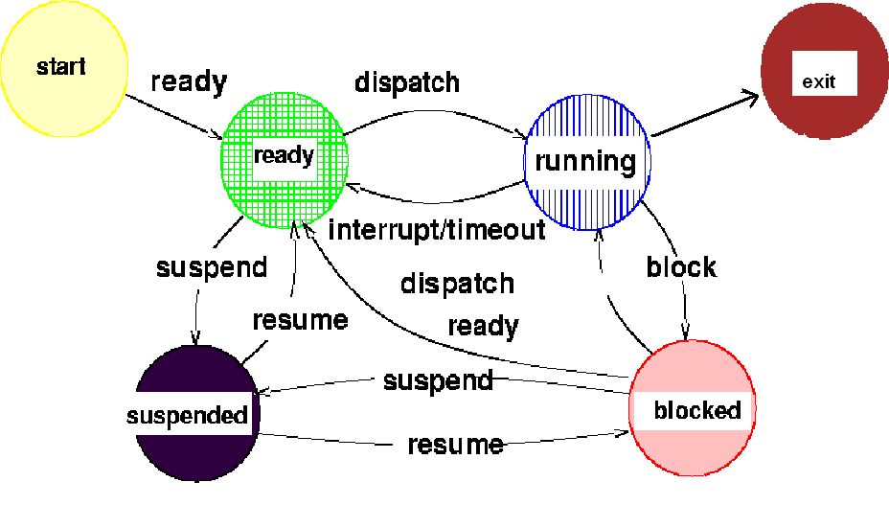
Process States Finite State Diagram
Copyright ©: Nahrstedt, Angrave, Abdelzaher
3
Notes:
3

Slide 4
Queueing Model
Random Arrivals modeled as Poisson process
Service times follow exponential distribution

Slide 5
Discussion
If a bus arrives at a bus stop every 15 minutes, how long do you have to wait at the bus stop assuming you start to wait at a random time?

Slide 6
Queuing Theory (M/M/1 queue)
Server
ARRIVAL RATE λ
(Poisson process)
Input Queue
SERVICE RATE μ
the distribution of inter-arrival times between two consecutive arrivals is exponential (arrivals are modeled as Poisson process)
service time is exponentially distributed with parameter μ

Slide 7
M/M/1 queue
The M/M/1 queue assumes that arrivals are a Poisson process and the service time is exponentially distributed.
Interarrival times of a Poisson process are IID (Independent and Identically Distributed) exponential random variables with parameter λ
- independent from each other!
Arrival times:
each interarrival Δ_{i} follows
an exponential distribution
Δ₁
Δ₂
t
Arrival rate λ
Service rate μ
CPU
Notes:
w = average time spent by an aperiodic task in the system. ρ = λ / μ;
λ = average arrival rate; μ = average service rate.

Slide 8
Appendix: exponential distribution
If τ is the exponential random variable describing the distribution of inter-arrival times between two consecutive arrivals, it follows that:
cumulative distribution
function (cdf)
The probability density function (pdf) is:
Δ
0
t
Arrival rate λ
Service rate μ
CPU
Probability to have the first
arrival within Δ is 1-e^{- λ Δ}

Slide 9
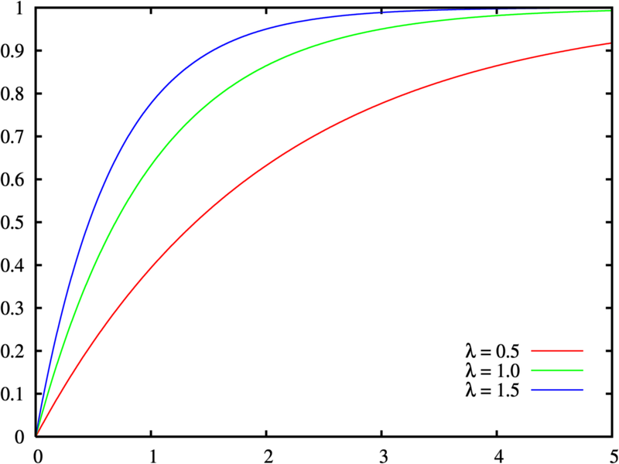
Queueing Theory
Queuing theory assumes that the queue is in a steady state
M/M/1 queue model:
Poisson arrival with constant average arrival rate λ (customers per unit time)
Each arrival is independent.
Interarrival times are IID (Independent and Identically Distributed) exponential random variables with parameter λ
What are the odds of seeing the first arrival
before time t?
See http://en.wikipedia.org/wiki/Exponential_distribution
for additional details

Slide 10
Analysis of Queue Behavior
Poisson arrivals: probability n customers arrive within time interval t is

Slide 11
Analysis of Queue Behavior
Copyright ©: Nahrstedt, Angrave, Abdelzaher
Probability n customers arrive within time interval t is:
Do you see any connection between previous formulas and the above one?
11
Notes:
11

Slide 12
Little’s Law in queuing theory
Copyright ©: Nahrstedt, Angrave, Abdelzaher
The average number L of customers in a stable system is equal to the average arrival rate λ times the average time W a customer spends in the system
It does not make any assumption about the specific probability distribution followed by the interarrival times between customers
W_{q}= mean time a customer spends in the queue
λ = arrival rate
L_{q} = λ W_{q} ➔number of customers in queue
W = mean time a customer spends in the entire system (queue+server)
L = λ W ➔ number of customers in the system
In words – average number of customers is arrival rate times average waiting time
12
Notes:
12

Slide 13
Analysis of M/M/1 queue model
Copyright ©: Nahrstedt, Angrave, Abdelzaher
Server Utilization:
mean time W_{s} a customer spends in the server is 1/μ, where μ is the service rate.
According to M/M/1 queue model, the expected number of customers in the Queue+Server system is:
Quiz: how can we derive the average time W in the system, and the average time W_{q} in the queue?
13
Notes:
13

Slide 14


Hamburger Problem
7 Hamburgers arrive on average every time unit
8 Hamburgers are processed by Joe on average every unit
Av. time hamburger waiting to be eaten? (Do they get cold?) Ans = ????
Av number of hamburgers waiting in queue to be eaten? Ans = ????
Queue
8
7

Slide 15
Example: How busy is the server?
μ=3
λ=2

Slide 16
How long is an eater in the system?
μ=3
λ=2

Slide 17
How long is someone in the queue?
μ=3
λ=2

Slide 18
How many people in queue?
μ=3
λ=2

Slide 19
Interesting Fact
As ρ approaches one, the queue length becomes infinitely large.

Slide 20
Until Now We Looked at Single Server, Single Queue
ARRIVAL RATE λ
Server
Input Queue
SERVICE RATE μ

Slide 21
Sum of Independent Poisson Arrivals
ARRIVAL RATE λ₁
Server
Input Queue
SERVICE RATE μ
ARRIVAL RATE λ₂
If two or more arrival processes are independent and Poisson with parameter λ_{i}, then their sum is also Poisson with parameter λ equal to the sum of λ_{i}
λ= λ₁+ λ ₂

Slide 22
As long as service times are exponentially distributed...
SERVICE RATE μ1
Server
ARRIVAL RATE λ
Combined μ=μ1+μ2
Input Queue
Server
SERVICE RATE μ2

Slide 23
Question: McDonalds Problem
λ
μ
λ
μ
λ
μ
λ
μ
λ
μ
λ
μ
A) Separate Queues per Server
B) Same Queue for Servers
Quiz: if W_{A} is waiting time for system A, and W_{B} is waiting time for system B, which queuing system is better (in terms of waiting time)?

